Slide 1
LUL Youth Development and Education Project
JKL Systems

Slide 2
Overview
Team Introduction
Opportunity
To-date summary
Class Diagram
ERD
ERD Table and Data Dictionary
User Interface Navigation
The Next Step
Notes:
Okay so here is just a brief overview of what will be covered in the presentation. I wasn’t sure what to call the previous stuff we’ve covered, so if you wanna change the name of that section feel free.

Slide 3
Opportunity
Creating an efficient reporting process, by centralizing data, to increase funding from donations and grants.
Notes:
He asked us to restate the problem, so instead of calling it problem I went with opportunity

Slide 4
To-Date Summary
As-Is Model
Areas of Opportunity
System requirements
To-Be Model
Preformed a Feasibility analysis
Business value
Use-Cases
Notes:
We created the as-is model. Which is how their system looks today
-We’ve reviewed the areas of opportunity to see how their system could be improved
The system requirements are what they need their system to do.
-We then created a to-be model.
We preformed a feasibilty analysis to see if the new system should be built.
-Next we looked at the business value of the new system
The use cases describe the systems function from a high level view…
*I’m not sure if this is what you all meant. But I just touched on the high level of items we reviews and you can just give a brief synopsis of them.

Slide 5
Definition
Class Diagram: a static structure diagram that describes the structure of a system by showing the system's classes, their attributes, and the relationships between the classes.
Notes:
This is the best definition I could think of for describing it in laymans terms. If anyone can think of something better feel free to change it

Slide 6
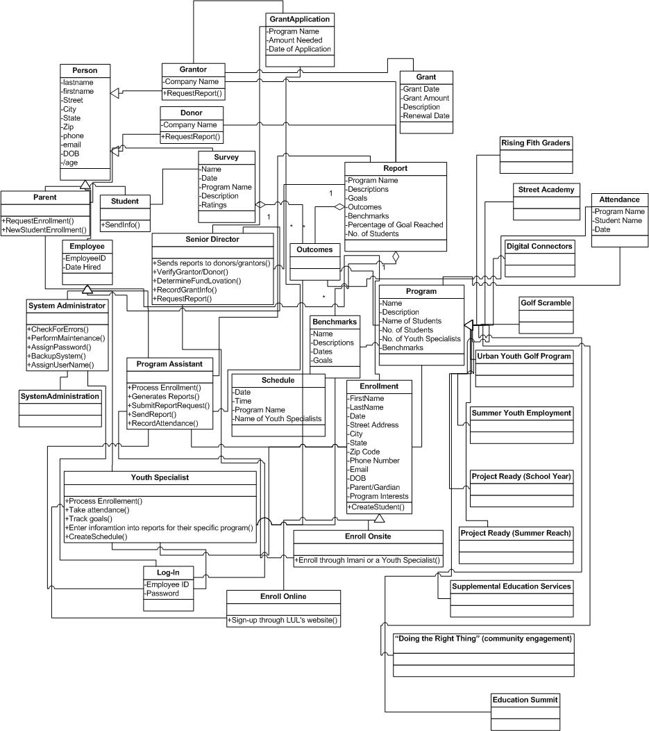
Class Diagram
Notes:
Okay so this is as good as I could get for this thing since its so large. Sorry. If you have any suggestions let me know.

Slide 7
Class Diagram Description
The classes will store and manage information in the system.
The diagram contains attributes of each class and methods.
Attributes are the properties we wish to capture information about and methods are actions that the class can perform.
Notes:
This was taken from kelli’s narrative.

Slide 8
Definition
ERD (Entity Relationship Diagram): models the relationships between entities in a database

Slide 9
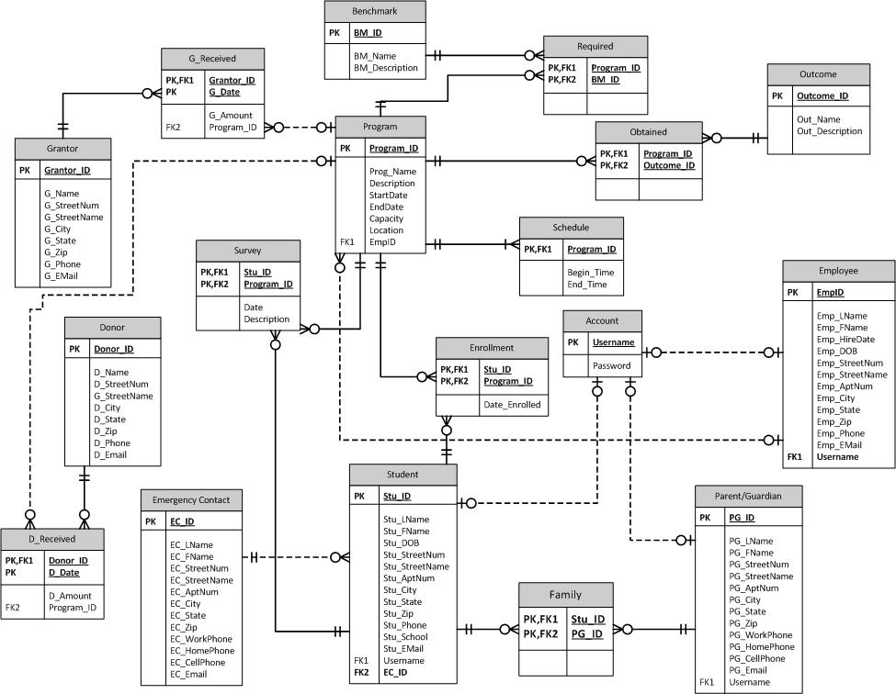
ERD
Notes:
Okay so this covers up the title, but I think you can see it a lot better if its bigger.
-You can just kinda go through some of the tables maybe and the relationships.

Slide 10
ERD Description
An entity is an object or concept, which stores data
A relationship is how the data is shared between entities.
The goals of an ERD are to eliminate redundancy and ensure data dependencies make sense.
Notes:
-this is from the ERD narrative. The entity sentence didn’t make a whole lot of sense to me so that description may not be right.

Slide 11
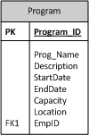
ERD Table
Notes:
Here is just an example of an entity. The data dictionary is on the next slide. Or I can combine them. Up to you?!

Slide 12
Data Dictionary
Here is an example of the data dictionary for the program entity:
PROGRAM
Key | Attribute | Definition | Max Data Size (in bytes) | Data Type
PK | PROGRAM_ID | UNIQUELY IDENTIFIES PROGRAM | 3 | INTEGER
 | PROG_NAME | NAME OF PROGRAM | 15 | VARCHAR
 | DESCRIPTION | DESCRIPTION OF PROGAM (AND ACTIVITIES) | 100 | VARCHAR
 | STARTDATE | START DATE OF PROGRAM | 10 | DATE
 | ENDDATE | END DATE OF PROGRAM | 10 | DATE
 | CAPACITY | MAXIMUM NUMBER OF STUDENTS ALLOWED TO ENROLL | 2 | VARCHAR
 | LOCATION | PLACE WHERE PROGRAM BEING RUN (HELD) | 15 | VARCHAR
 | EMP_ID | IDENTIFIES EMPLOYEE (YOUTH SPECIALIST) RESPONSIBLE FOR RUNNING AND OVERSEEING PROGRAM | 5 | INTEGER

Slide 13
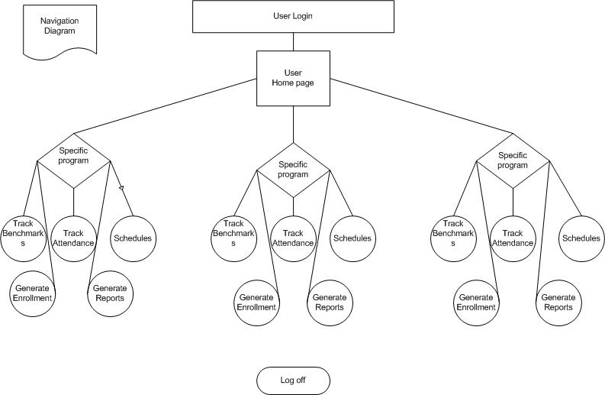
User Interface Navigation
Notes:
Here is the navigation form…however I don’t know if we need this or not. You can fill free to delete it

Slide 14
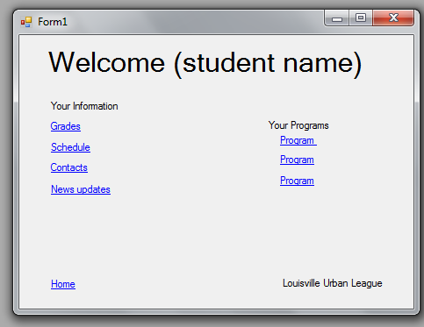
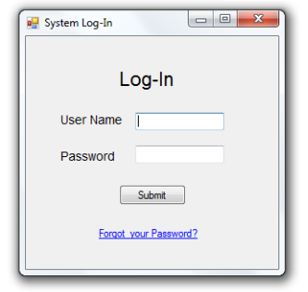
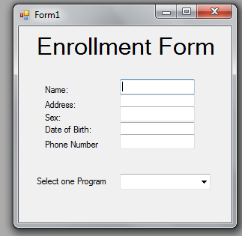
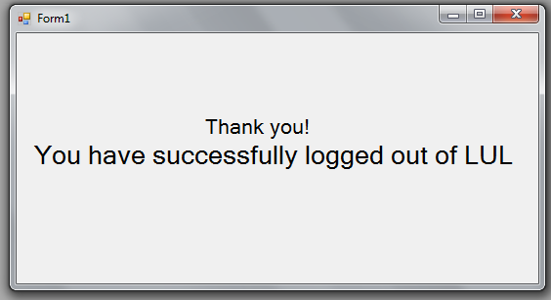
User Interface Navigation
Notes:
Okay so here is what I have… His narrative explains each of the forms.

Slide 15
The Next Step: GANTT CHART

